Slide 1
Lesson objective
PBiS focus
Respect – each other
Achieve – attempting all tasks
Title: Metric conversions
Aim:
Be able to convert units involving capacity
Plan:
Daily review: area formula
Key ideas: volume and capacity
Skills practice

Slide 2
Daily review
Formulas are like rules we can follow with numerous mathematical applications.
The formula for the area of a rectangle is A = length x width
What is the formula for the area of a triangle and why?

Slide 3
Area
Calculate the area of these shapes with out a calculator.
5cm
8cm
12m
13cm
5.5m
8cm

Slide 4
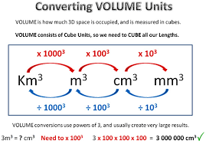
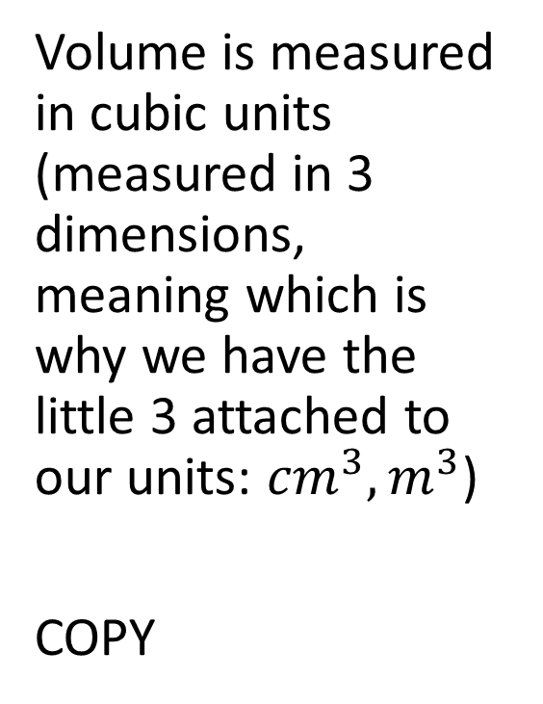
Key ideas
Volume is measured in cubic units (measured in 3 dimensions, meaning which is why we have the little 3 attached to our units: ${cm}^{3}, m^{3}$)
COPY

Slide 5
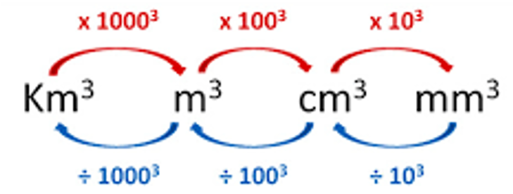

Conversions: I do
${5m}^{3}$ ➔ ${cm}^{3}$
${1000m}^{3}$➔ ${Km}^{3}$

Slide 6

Conversions: We do
${9m}^{3}$ ➔ ${cm}^{3}$
${5000m}^{3}$➔ ${Km}^{3}$
${3cm}^{3}$ ➔ ${mm}^{3}$

Slide 7

Conversions: you do
${10m}^{3}$ ➔ ${cm}^{3}$
${3000m}^{3}$➔ ${Km}^{3}$
${9cm}^{3}$ ➔ ${mm}^{3}$

Slide 8
Skills practice
“why did the worker get fired from her job in the mattress factory?
“Who sailed with the ghostship?”

